Slide 1
Clock and temperature reading project
Omnia Nabil 12020156
Sohaila Mohammad Kandil 120200062

Slide 2
TABLE OF CONTENTS
01
02
03
Layered architecture
The Clock code
Temperature sensing code

Slide 3
Project description
In this project we display the temperature continuously on an LCD and each second the new time in hours, minutes and seconds is displayed on the LCD

Slide 4
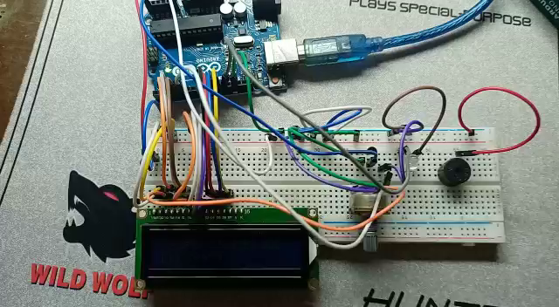


Slide 5
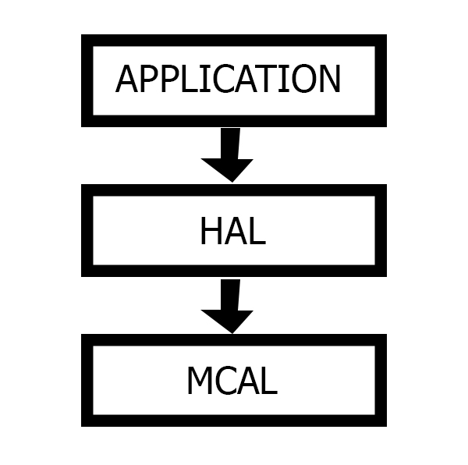
The layered architecture
The layered architecture helps in making the code well organized and user friendly.

Slide 6
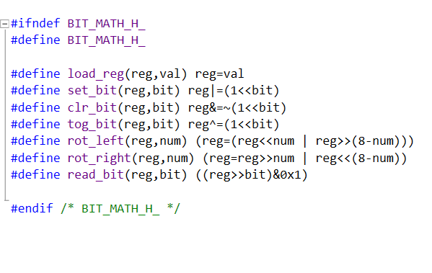
Defining the basic registers operations
These functions are called the macro definitions and they do the basic operations on registers

Slide 7
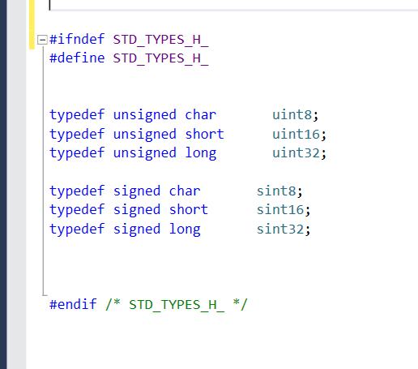
Defining some data types

Slide 8
MCAL

Slide 9
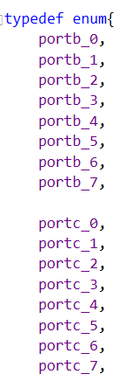
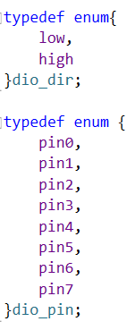
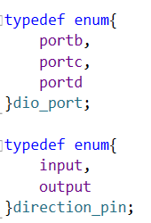
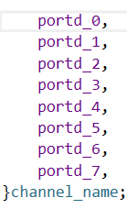
DIO_types.h file
Defining all the channels names ,data directions, pins numbers, ports names. Makes the codes user friendly and makes it easier to debug the code if we use another microcontroller.

Slide 10
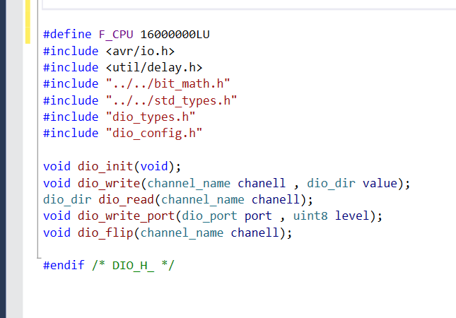
DIO.h file
In this file we define all the digital input output functions we will implement in dio.c file

Slide 11
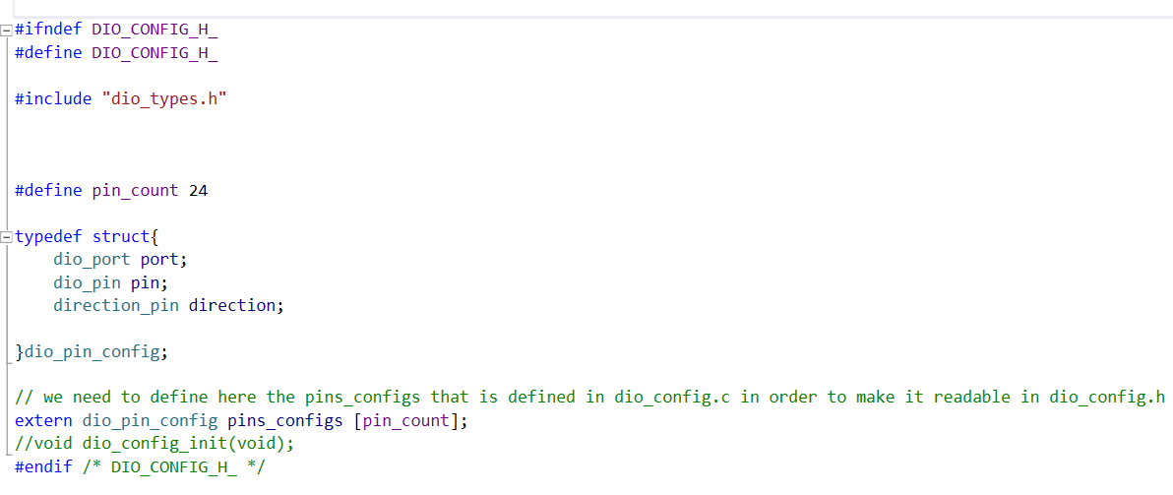
DIO.config.h file
In this code we define a structure that can hold the port name, the pin number and the data direction either input or output.

Slide 12
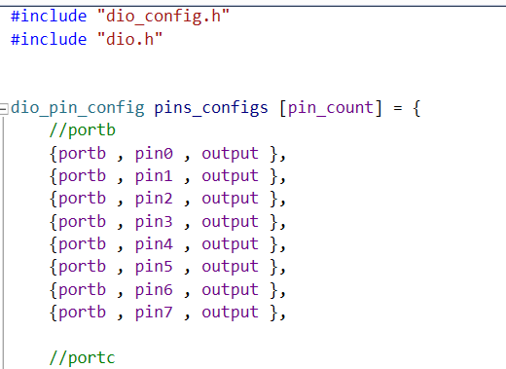
DIO.config.c file
In this file we made a list with elements of some structs that holds each register and pin and the information of whether this pin is set as an input or an output pin

Slide 13
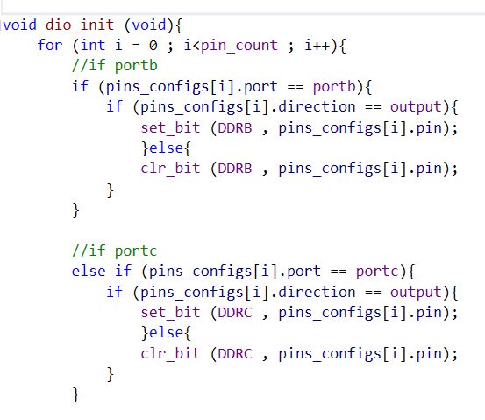
DIO.c file
The dio_init() function is setting the DDRX registers to settle the configurations for all pins if they are output or inputs

Slide 14
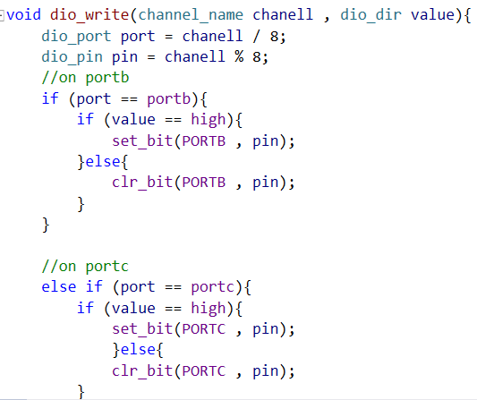
DIO.c file
The dio_write() function is writing a specific value to a channel in the microcontroller.

Slide 15
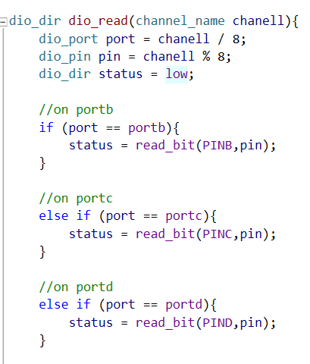
DIO.c file
The dio_read() function is reading a specific value from a channel in the microcontroller.

Slide 16
HAL

Slide 17
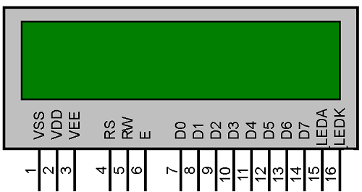
LCD configuration

Slide 18
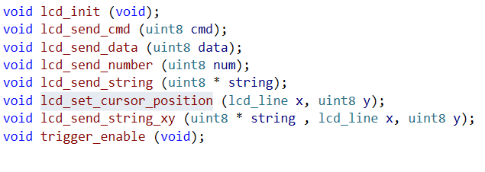
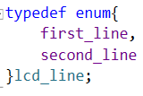
LCD.h file
Here we define all the functions we need for the lcd

Slide 19
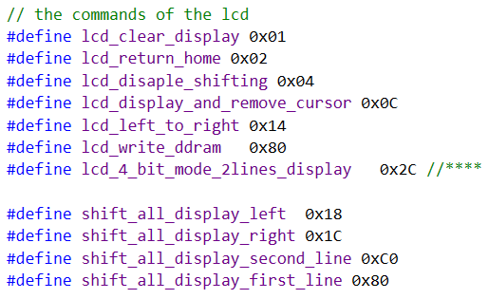
LCD.h file
Here we define all the commands we need for the lcd.

Slide 20
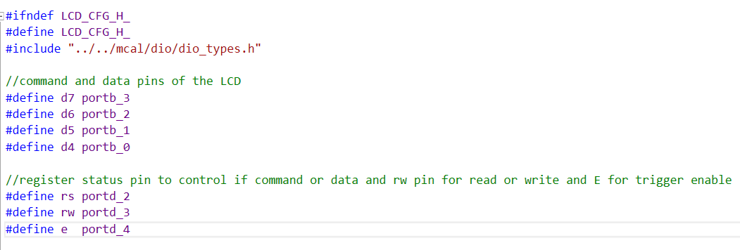
LCD_config.h file
Here we set the pins configurations of the lcd.

Slide 21
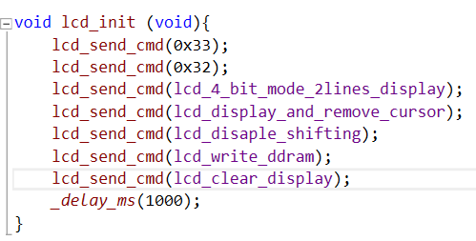
LCD.c file
In the init function we set the lcd to the initial stage to make it ready to display images

Slide 22
Application layer

Slide 23
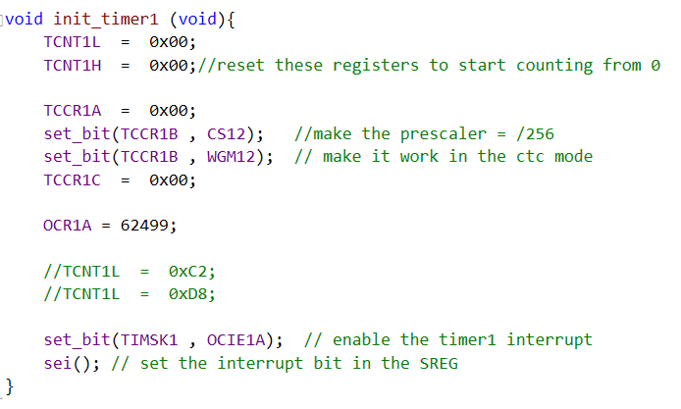
Main.c file
In this piece of code we set the timer registers and set the interrupt on.

Slide 24
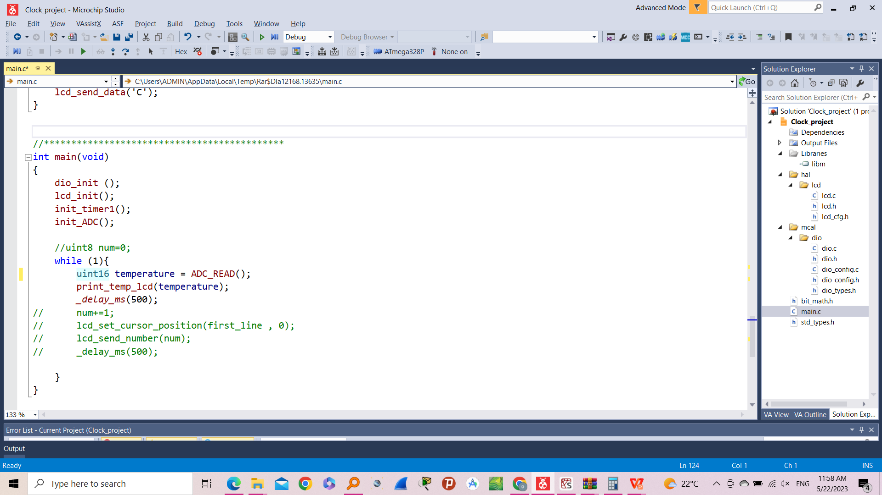
Main.c file
In this piece of code the code is reading the temperature but sense we have called the init_timer1() function, once a second has passed the interrupt service routine will be called.
ADC_READ() functiion read the value from the temperature sensor and saves in variable temperature.

Slide 25
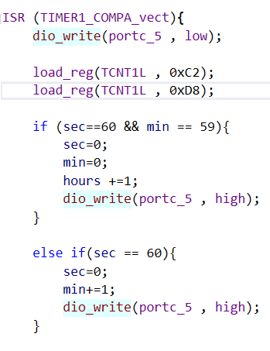
The ISR of the clock

Slide 26
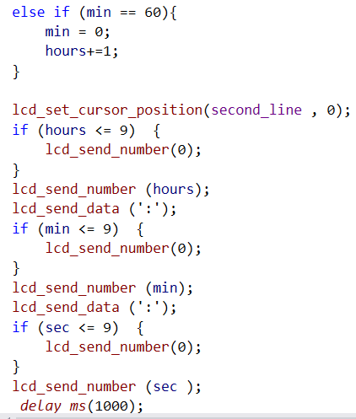
The ISR of the clock

Slide 27
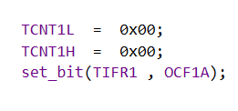
The ISR of the clock
Finally at the ISR make sure to reset the TCNT registers for the coming interrupt.

Slide 28
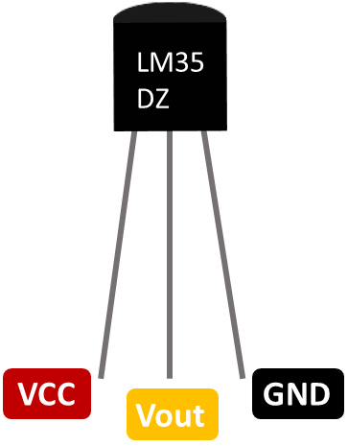

Slide 29
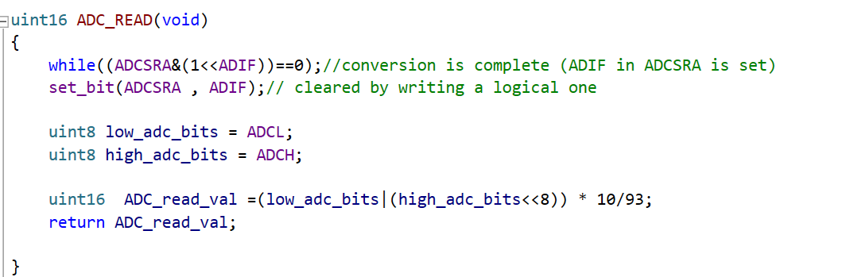
ADC_READ
starts a while loop that continues until the value of the ADC Interrupt Flag (ADIF) bit in the ADCSRA register becomes 1. It waits for the ADC conversion to finish.
combines the lower 8 bits (low_adc_bits) and the upper 2 bits (high_adc_bits) of the ADC result to form a 10-bit ADC reading. It then performs some scaling or calibration operation on the ADC reading and assigns the result to the variable ADC_read_val.

Slide 30
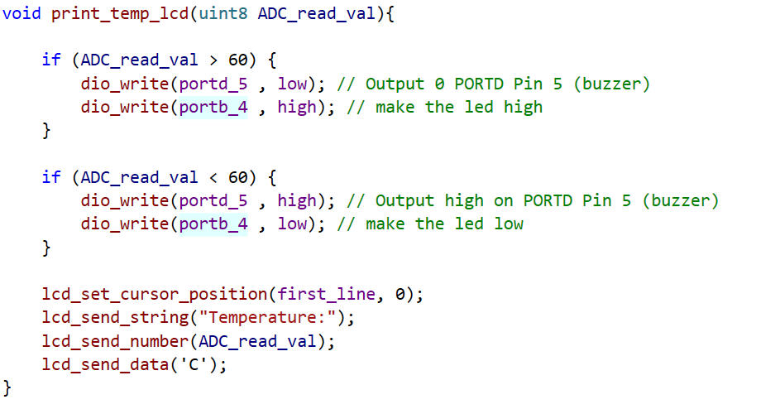
Main and print_temp_lcd
the temperature variable take value from ADC_READ.
pass to function print_temp_lcd
to show the temperature value on lcd.
Start on line 1 position 0 in lcd

Slide 31
THANKS

